Slide 1
LSDC Final Presentation
Group 03
Stefan Derkits
Jan Vales
Andreas Egger

Slide 2
Outline
Architecture
Scheduler overview
Evaluation
Performance metrics
Conclusion

Slide 3
Architecture
Cmdline Java program
  all Scheduler-Scenario combinations
  configurable by build file
    Nr cloudpartners, PMs
MachineManager
  Handling of PMs, VMs
Scheduler
  Assign applications to VMs
  Delay applications
  Migration
  Federation

Slide 4
Statistics
Totals
  25 Classes
  172 Functions
  1602 LoC
Schedulers
  5 Classes
  43 Functions
  582 LoC

Slide 5
Scheduler
Scheduler A
  1 VM per application
Scheduler B
  Resize VMs
  Migration
Scheduler C
  Migration
  No Resizing
All Schedulers
  Federation

Slide 6
Scheduler C (detail)
Resource allocation
  Multiple apps per VM
  1 VM per PM
  No resize -> reserve max space
  Migration (bin packing)
Advantages
  No resize costs → better energy utilization
  Easier code → better maintainability
  Minimization of PMs
Disadvantage
  Less secure

Slide 7
Evaluation
Testdata
  500 Applications
  Duration from 85 to 175 (normal distributed)
  Multiple applications per timestamp
  Scenarios A-C

Slide 8
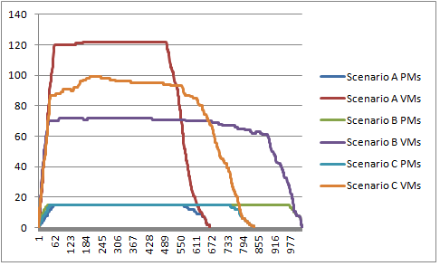
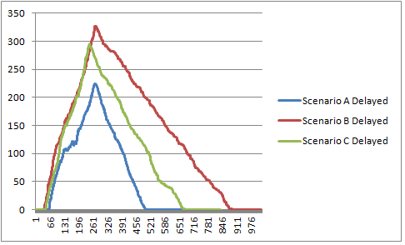
Performance (Scheduler A)

Slide 9
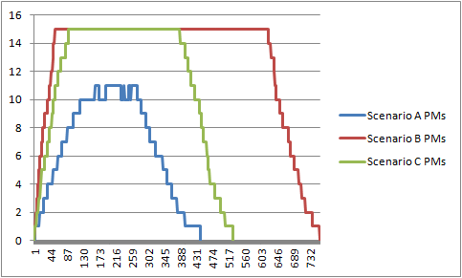
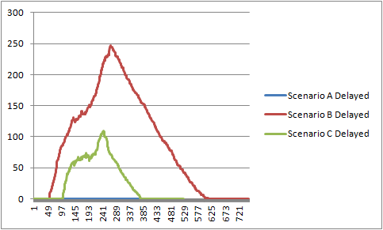
Performance (Scheduler B)

Slide 10
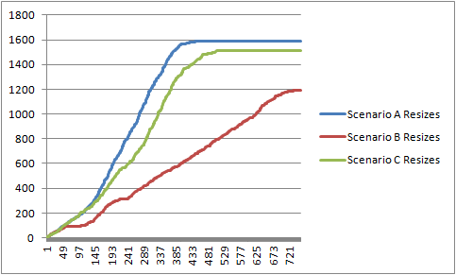
Performance (Scheduler B)

Slide 11
Performance (Scheduler C)

Slide 12
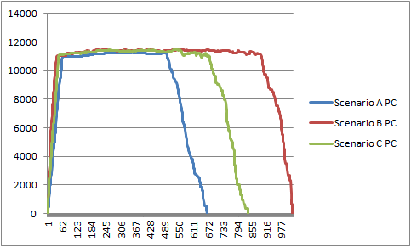
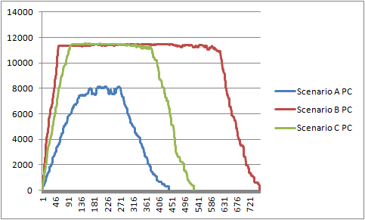
Energy Consumption
Scheduler A Scheduler B Scheduler C

Slide 13
Conclusion
Intelligent scheduling saves energy
Migration is the key
Additional savings in resize operations

